Slide 1

NCCOC SECOND QUARTER MEETING MAY 7, 2022 (VIRTUAL) MEMBERSHIP CHAPTER REPORTS
ALL NCCOC CHAPTERS COMPLETED AND SUBMITTED SEMI-ANNUAL REPORTS FOR SECOND SEMESTER AS OF 31 DEC. 2021. THANK YOU!
CHAPTER MEMBERSHIP TRENDS SINCE THEN ARE DIFFICULT TO TRACK BUT BY REVIEWING THE CM’S FROM THE CHAPTERS ALLOWING ACCESS, WE ARE STEADY ON TOTAL MEMBERSHIP.
FROM CM INFO COLLECTED ON MAY 4, 2022, TOTAL MEMBERS ADDED AND OR LOST SINCE APRIL 4, 2022 IS ZERO.
TO COMPLETE A REVIEW OF TOTAL MEMBERSHIP FOR ALL CHAPTERS, REQUEST TOTAL MEMBERSHIP FROM THE FOLLOWING CHAPTERS: CAPE FEAR NC-01, AND TARHEEL NC-08.

Slide 2
CHAPTER OFFICER REPORT PROGRESS SHOWS IMPROVEMENT FROM LAST MEETING APRIL 8TH
CHAPTERS UPDATED: TARHILLS NC-08 & WESTERN NC-10
NEED UPDATES FROM: COASTAL NC-02, SANDHILLS NC-06, TRIANGLE NC-09, PIEDMONT NC-14, FIRST FLIGHT NC-17, CENTRAL NC-20, HIGH COUNTRY NC-21.

Slide 3
NCCOC CHAPTER OFFICER REPORT FORM
FOUND ON WEBSITE BACKROOM, LOOK FOR (N) FORM
GO TO NCCOC WEBSITE TO VIEW NEW FORM
FORM IS DOWN LOADABLE WITH FILL IN OPTION
REQUEST UPDATE SEMI-ANNUALLY OR WHEN LEADERSHIP CHANGES OCCUR

Slide 4
IDEAS TO INCREASE MEMBERSHIP
EVERY MEMBER INVITIE SOMEONE TO THE NEXT EVENT
CHAPTER OFFICERS CHECK ON NON-ATTENDEES’ HEALTH
USE COMMON JOIN FORM AND NRT LIST FROM MOAA
SCHEDULE A SUMMER SOCIAL EVENT WITH NO BUSINESS

Slide 5
GOALS FOR NC CHAPTERS 2022
INCREASE MEMBERSHIP BY 5% IN 2022
UPDATE YOUR CHAPTER OFFICER REPORT TO NCCOC OFTEN
SEND CHANGES TO MOAA’s COMMITTEE MODULE MONTHLY
REVIEW YOUR MEMBERSHIP ROSTER FOR CONTACT INFO
KEEP IT CURRENT AND TRACK FOR TRENDS.

Slide 6
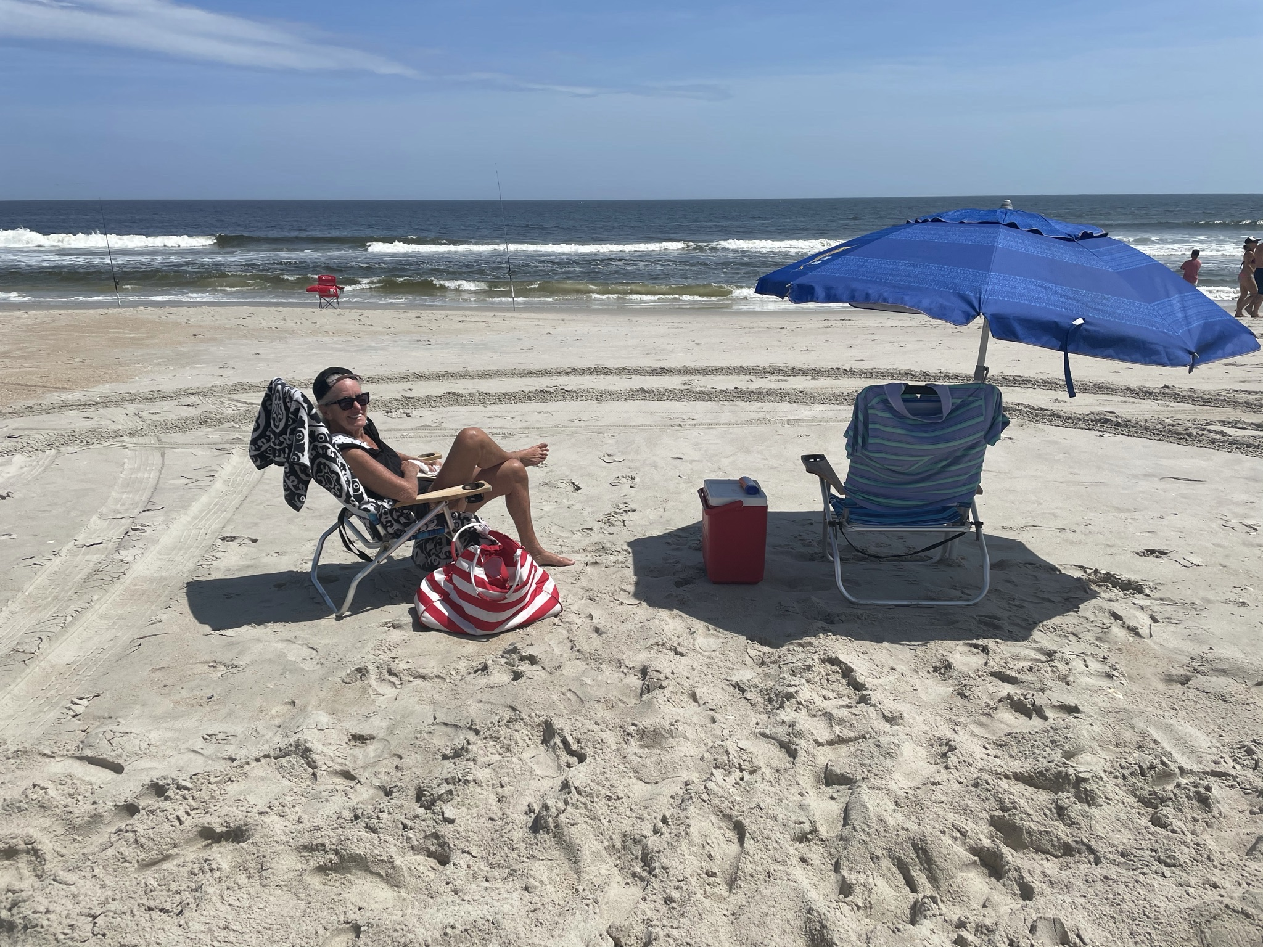
TAKE A BREAK!

